Slide 1

Time Limits in Personal Injury Claims – Tricks and Traps
Beth Rolton, Partner and Cairns Office Leader
Travis Schultz and Partners

Slide 2



Slide 3

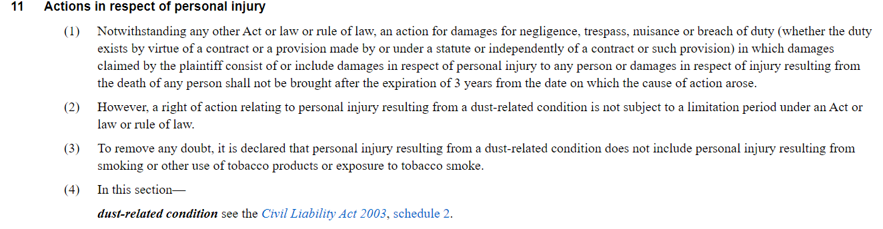
What are the time limits in Queensland?
Limitation of Actions Act 1974 (Qld)
Bullet points em lam eaqui aut
Bullet points bullet points caboris ut quossi
Bullet points bullet points caboris ut quossi

Slide 4
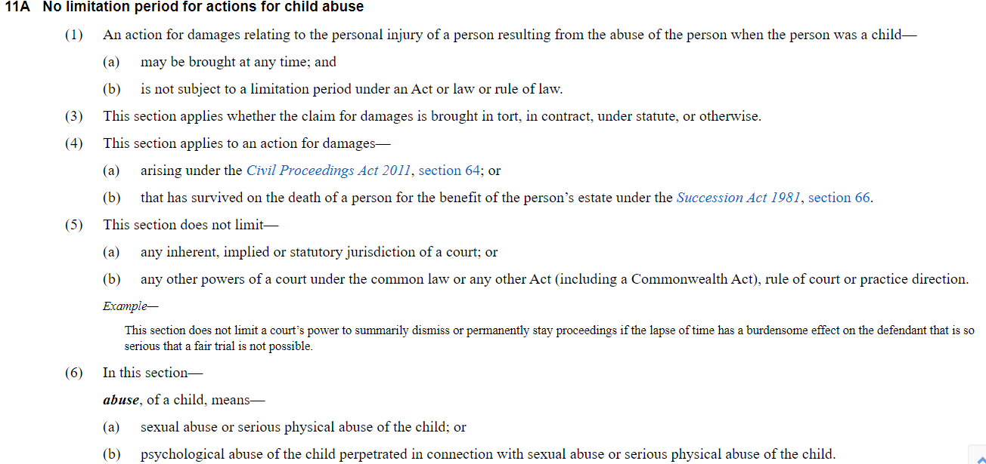

Slide 5
Civil Aviation (Carriers' Liability) Act 1959 (Cth) and
Civil Aviation (Carriers' Liability) Act 1964 (Qld)
The right to damages shall be extinguished if an action is not brought within two years, reckoned from the date of arrival at the destination, or from the date on which the aircraft ought to have arrived, or from the date on which the carriage stopped.
The method of calculating the period of limitation shall be determined by the law of the Court seised of the case.

Slide 6

When does the cause of action accrue?
Facts or combination of facts which give rise to a right to bring a civil proceeding. In a personal injury action this will, by definition, be the point at which the plaintiff suffers damage.
The general rule is that a cause of action accrues at ‘the earliest point at which an action could be brought.’ Reeves v Butcher [1892] 2 Q.B. 509
The usual principle is that a cause of action in negligence is complete when loss or damage is sustained. Hawkins v. Clayton [1988] 164 CLR 539

Slide 7
When does a person suffer damage?
What is ‘damage’?
What is the minimum actionable damage; and
When is the damage suffered?

Slide 8
What is the minimum actionable damage?
In Cartledge & Ors v E Jopling & Sons Ltd [1963] AC 758, Lord Reid held that in cases of personal injury a cause of action accrues:
As soon as a wrongful act has caused personal injury beyond what is regarded as negligible, even when that injury is unknown to and cannot be discovered by the sufferer.
In Melisavon Pty Ltd v Springfield Land Development Corporation Pty Ltd [2014] QCA 233, McMurdo P succinctly summarised the position as follows:
‘It is well-established that, ordinarily, a cause of action in tortious negligence arises when a plaintiff first suffers material damage or relevant loss, providing the damage is more than negligible and the loss measurable. The cause of action is complete even if the plaintiff is unaware of the damage.’

Slide 9
Person with a disability? Infants and Unsound Mind
Section 5(2) of the LLA states that a person shall be taken to be under a disability while the person is an infant or of unsound mind. ‘Child’ is defined in the Act Interpretation Act 1954 as an individual who is under 18.
Section 5(3) of the LLA presumes a person is of unsound mind while they are an involuntary patient under the Mental Health Act, has a forensic disability client under the Forensic Disability Act detained in an authorised mental health service under an order of the court or in safe custody.
Incarceration is not a legal disability and normal timeframes will apply to incarcerated people.
Time does not run against infants or persons under some legal disability
In the case of a disability, s29(2)(c) LAA allows for an extension of time of 3 years from the date on which that person ceased to be under a disability or died, whichever event first occurred.

Slide 10
Claims under the Workers’ Compensation and Rehabilitation Act 2003 (WCRA)

Slide 11
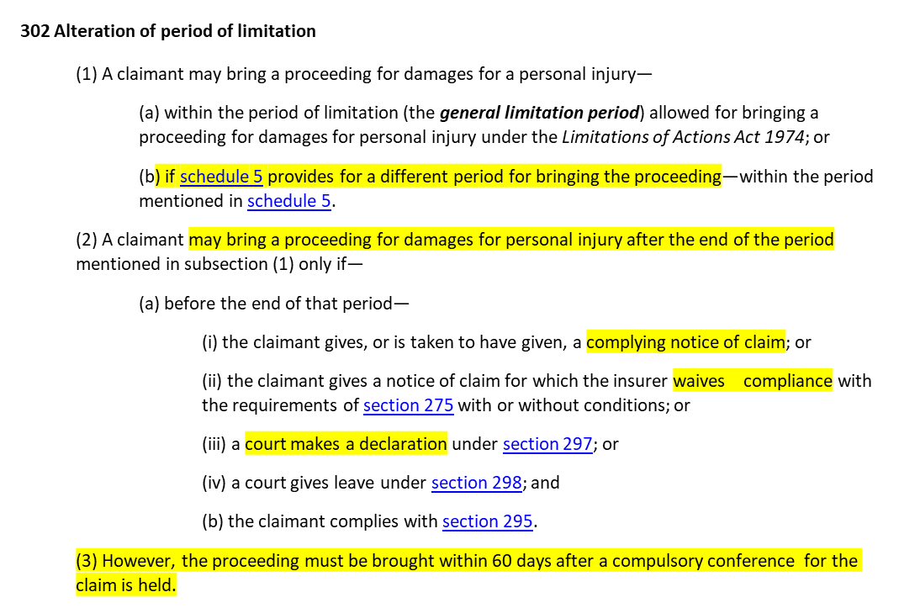
Claims under the Workers’ Compensation and Rehabilitation Act 2003 (WCRA)

Slide 12
Time for applying for Workers’ Compensation benefits?
s. 131 Time for applying
An application for compensation for an injury is valid and enforceable only if the application is lodged by the claimant within 6 months after the entitlement to compensation for the injury arises.
s. 235A Date of relevant health practitioner consultation taken to be date of injury
For the application of this chapter in relation to an injury sustained by a worker that happens over a period, the date on which the worker first consulted a relevant health practitioner about the injury is taken to be the date of the worker’s injury.

Slide 13
What happens if the injured worked doesn’t lodge a statutory claim within 6 months or at all?
S 237(1)(a)(i) of the WCRA states that only a person who has received a notice of assessment for an injury is entitled to seek damages. Therefore, if the worker doesn’t have this notice they cannot lodge a compliant Notice of Claim for Damages.
S 132A permits an injured worker to apply for assessment of degree of permanent impairment if no application has been made for compensation.
A Top Class Turf Pty Ltd v Parfitt [2018] QCA 127 – If application for compensation is rejected for being out of time, the worker can still request an assessment of their degree of permanent impairment under s132A

Slide 14
What if the Notice of Assessment is not issued within 3 years?
Schedule 5 Period of limitation
1 Worker who requests or is given notice of assessment
(1) This section applies if—
  less than 6 months before the end of the general limitation period, an insurer gives a worker a notice of assessment for an injury; or
  before the end of the general limitation period—
    a worker asks an insurer to have the worker’s injury assessed to decide if the injury has resulted in a DPI; and
    the insurer has not given the worker a notice of assessment for the injury.
(2) A proceeding for damages for the injury may be brought—
  within 6 months after the insurer gives the notice of assessment for the injury; or
  if, before the end of the period mentioned in paragraph (a), the worker advises the insurer that the worker does not agree with the DPI stated in the notice of assessment for the injury—within 6 months after a tribunal decides the DPI.
Sankey v GPC Asia Pacific Pty Ltd [2022] QSC 213

Slide 15
What if the injury has occurred over a period of time that spans more than 3 years? How can you include the entire period of the negligent conduct within the claim?
Schedule 5 of the WCRA only extends the general limitation period.
Consideration must then be given to s. 31(2) of the LLA. This section permits a person whose action is statute barred to seek a limited extension of the limitation period if they can show a material fact of a decisive character. The period of limitation can be extended for one year after the date of these facts coming into the knowledge of the Applicant (s31(2)).
The test: To be a ‘material fact of a decisive character’ - The facts must be known to the plaintiff and be of a decisive character so as to satisfy the element of the test.

Slide 16
Considerations
When did the negligent conduct start;
If that was greater than 3 years ago, what have they learnt in the last 12 months that changes their understanding of their injury?
Consider:
  Specialist opinion not known to the plt (Greenhalgh v Bacas Training Ltd)
  Finding out that plt is now predisposed to further injury if they continue working (Arnott v Qantas Airways Ltd)
  Expert opinion that differed from GP advice (Dent v Langs Building Supplies Pty Ltd)
  Increased likelihood of success in action from a mere possibility to a real likelihood (Sugden v Crawford)
  Critical liability evidence that proves case and increases prospects (AB v State of Queensland & Anor)
See Zimmerle v WorkCover Queensland & Another [2022] QDC 143

Slide 17
Zimmerle v WorkCover Queensland & Another [2022] QDC 143
Spray painter between 2006 and April 2016 – only employer he worked for where the workplace had poor ventilation and inadequate PPE
First experienced symptoms in 2009
Between 2009 and April 2016 told his employer that he was suffering illness caused by his work and attended on various doctors
Various specialists had confirmed the link between his symptoms and the inadequate ventilation
Redundant in April 2016
Engaged law firm in May 2016
Lodged WorkCover claim in December 2016
May 2018 – Lawyers spoke to Dr Brown, respiratory specialist who confirmed that the claimant’s symptoms were due to long term exposure to fumes and that none of his other previous employers contributed to the development of injury
May 2019 – Lawyers lodged an urgent Notice on WorkCover citing new material fact being the conversation with Dr Brown on 15 May 2018.

Slide 18
How can you stop a s.31 limitation period from expiring?
Section 276 of the WCRA, allows for the injured worker to lodge an incomplete, non-compliant Notice of Claim for Damages with an explanation of the urgency and ask the insurer to waive compliance.
The insurer then has 3 business days to advise the claimant if they agree or do not agree that there is an urgent need to start proceedings. If the notice is not given within 3 clear business days, the insurer may not waive non-compliance before the expiration of the limitation period and the claim will be statute barred (Handover v Consolidated Meat Group [2009] QSC 041).
If the insurer does not agree that there is an urgent need to commence and/or waiver conditions cannot be agreed to, the injured worker can bring an application for leave to commence proceedings despite noncompliance pursuant to s. 298.

Slide 19
Scenario
David was a baggage handler since 2001.
On 26 July 2022 feels pain in his right shoulder for the first time doing his normal work duties and has to stop work.
Diagnosed with right shoulder bursitis, rotator cuff tendonitis and a SLAP tear.
IME doctor reviews MRI and forms the opinion that his right shoulder had multiple pathologies, some of which are long standing.
On 14 March 2023 David gets legal advice.
Insurer file reviewed (29 April 2023) and second opinion sought (12 May 2023)
On 12 May 2023 David learns of the IME report and the second opinion of the specialist.
See Torpy v Qantas Airways Limited [2019] QDC 277

Slide 20
s. 298 Court to have given leave despite noncompliance
Subject to section 296, the claimant may start the proceeding if the court, on application by the claimant, gives leave to bring the proceeding despite noncompliance with the requirements of section 275.
The order giving leave to bring the proceeding may be made on conditions the court considers necessary or appropriate to minimise prejudice to the insurer from the claimant’s failure to comply with the requirements of section 275.

Slide 21
Time Limits under the Motor Accident Insurance Act 1994 (MAIA)
Section 37 (2)(b) claims must be lodged within 1 month of first consulting with a lawyer about the possibility of making a claim or nine months from the first appearance of symptoms following an accident (whichever is earlier). If not lodged within this time period, the claimant must provide a reasonable excuse for the delay.
Section 40 extends this period for minors or those under a legal disability until the incapacity ends.
Section 39 (8) claims against the Nominal Defendant for an unidentified vehicle are statute barred if the Notice of Claim is not lodged within 9 months after the motor vehicle accident.
Section 51D (1)(a) proceeding must be commenced within 60 days of the compulsory conference. If the claim is not started within these 60 days (provided the general 3 year limitation period has not expired) s. 51D(4) allows a claimant to start their action after the 60 days but a Court may order that the claimant pay the insurer’s costs caused by the delay.

Slide 22
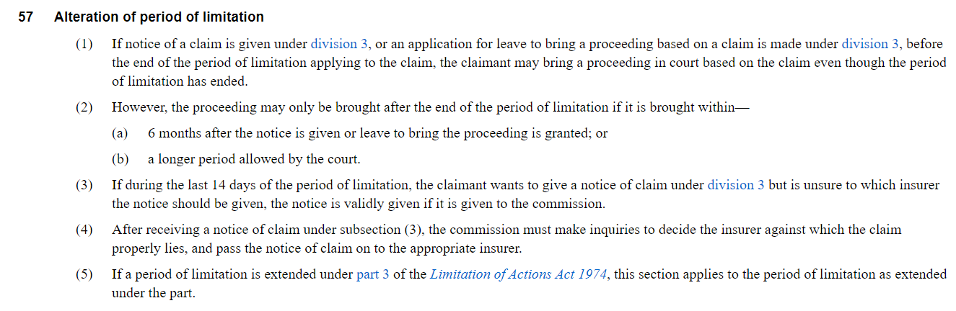
If the claimant’s limitation period is approaching and the necessary pre-court processes have not been complied with, what steps can be taken to ensure the claim doesn’t become statute barred?

Slide 23
Applications under section 57(2)(b)
s. 57 of the MAIA can only be relied on if the claimant has given a complying NOAC or an application for leave prior to the limitation period expiring. If the Claimant has given a complying NOAC before the limitation periods expires and an application is made under this section for court leave to commence after the end of the limitation period the Court has unfettered discretion to make the order.
Taskensen v Pumford & Anor [2006] QDC 069 - Notice of claim was non-compliant. The limitation period expired and an application was made pursuant to s. 57 for leave to proceed outside the 3 year limitation period. Held: in the absence of a complying NOAC or an application for leave prior to the limitation period expiring meant the Court had no discretion under S. 57 to allow the claimant leave to proceed.
Morrison-Gardiner v Car Choice Pty Ltd [2005] 1 Qd R 378 – compliant notice was served and liability admitted prior to the limitation period expiring. Pre-court steps not completed before the limitation period expired. Brought an application after the expiry of the 3 years under s.57(1).
The Court referred to the context in which s 57(2)(b) exists and said:
“The discretion to permit the commencement of proceedings after the expiration of a limitation period is to be exercised in this context. It is clearly meant to ameliorate the plight of a claimant who is unable to comply with the requirements of the Act in time to commence proceedings and who, if justice is to be done, should be given the extension. The discretion is likely to be exercised favourably only in those cases where a claimant’s circumstances make it difficult to comply with the requirements of the Act and commence proceedings within three years or where, despite making conscientious efforts to comply with the requirements of the Act, a claimant nevertheless does not do so within three years of the accident. Any delay on the part of a claimant in complying with the Act’s requirements or in applying for an extension of time will be relevant to the exercise of the discretion. Claimants who ignore the obligations imposed on them by the Act or who make no conscientious effort to comply with them are unlikely to obtain an extension of time though, of course, each case must be decided on its individual merits.” Emphasis added

Slide 24
Applications under section 39(5)(c)(ii)
(5) A claimant’s failure to give notice of a claim as required under this division prevents the claimant from proceeding further with the claim unless—
(a) the insurer—
(i) has stated that the insurer is satisfied notice has been given as required under this division or the claimant has taken reasonable action to remedy the noncompliance; or
(ii) is presumed to be satisfied notice has been given as required under this division; or
(b) the insurer has waived compliance with the requirement; or
(c) the court, on application by the claimant—
(i) declares that the claimant has remedied the noncompliance; or
(ii) authorises further proceedings based on the claim despite the noncompliance.

Slide 25
Considerations
Considerations other than the need to comply with the Act which will usually be relevant include:
  length of the delay;
  whether there has been a general lack of diligence in the prosecution of the claim;
  whether the prospects of a fair trial are diminished; and
  whether an exercise of the discretion will deny the defendant a complete defence.

Slide 26
Scenario
The claimant was involved in a car accident on 8 May 2013 – engages a lawyer but doesn’t provide them with enough information to complete the Notice of Accident Claim form.
In April 2016, the claimant recalls having the accident almost three years ago and gets back in contact with her solicitor who refers her to her current solicitor on 11 May 2016.
The new solicitor served a Notice of Accident Claim form on 19 May 2016
On 29 June 2016 the insurer rejected the excuse for delay and not accept the claim.
See Djuric v Wai Kit & Anor [2016] QDC 194

Slide 27
Time limits under the Personal Injuries Proceedings Act 2002
s. 9(3) – The Part 1 Notice must given on the earlier of the following:
  9 months after the day the incident giving rise to the personal injury happened or, if symptoms of the injury are not immediately apparent, the first appearance of symptoms of the injury;
  1 month after the day the claimant first instructs a law practice to act on the person’s behalf in seeking damages for the personal injury and the person against whom the proceeding is proposed to be started is identified.
s. 9A – must give an initial notice within 9 months of the medical incident or 1 month of first instructing a law practice.
s. 9A(6A) – reasonable excuse if the notice is given within a reasonable time after receiving a finalised decision from one of the various bodies that are authorised to investigate complaints (e.g. AHPRA)
s. 9A(9) – within 12 months of giving the initial notice, the claimant must give their Part 1 notice with a written report form a medical specialist
S. 42 Time for starting proceeding – within 60 days after the compulsory conference or a further period agreed within the 60 day period or fixed by a court

Slide 28
Special provisions for notification of claims in relation to injuries to children arising out of medical treatment – Division 1A
A parent or legal guardian must give a Part 1 NOC before the earliest of:
  The day 6 years after the day the parent/LG knew or ought reasonably to have known that a personal injury had occurred – s20B;
  The day 18 months after the day the parent/LG first consults a lawyer about the possibility of seeking damages for the personal injury.
A practitioner acting for a parent/LG, must give the Part 1 NOC as soon as practicable after being instructed. A failure by the practitioner to comply with 20C(2) is professional misconduct.

Slide 29
Claims under the Personal Injuries Proceedings Act - Starting urgent proceedings by agreement
Section 44 PIPA avoids the need to bring an application under s 43.
43 Starting urgent proceeding with the court’s leave
(1) The court, on application by a claimant, may give leave to the claimant to start a proceeding in the court for damages based on a liability for personal injury despite noncompliance with this part if the court is satisfied there is an urgent need to start the proceeding.
(2) The order giving leave to start the proceeding may be made on conditions the court considers necessary or appropriate having regard to the particular circumstances of the case.
(3) However, if leave is given, the proceeding started by leave is stayed until the claimant complies with this part or the proceeding is discontinued or otherwise ends.
(4) Despite subsection (3), the proceeding is not stayed if—
………..

Slide 30
44 Starting urgent proceeding by agreement
(1) The purpose of this section is to enable a claimant to avoid the need to bring an application under section 43.
(2) Without limiting section 43, if the claimant believes there is an urgent need to start a proceeding for a claim despite noncompliance with this part, the claimant may, in the claimant’s notice of claim—
(a) state the reasons for the urgency and the need to start the proceeding; and
(b) ask the person or persons against whom the proceeding is proposed to be started (proposed respondent) to allow the claimant to start the proceeding despite noncompliance with this part.
…………………………………
(8) If each proposed respondent agrees to allow the claimant to start the proceeding despite noncompliance with this part—
(a) the claimant may start the proceeding; and
(b) the proceeding is stayed until the claimant complies with this part or the proceeding is discontinued or otherwise ends.
………..

Slide 31
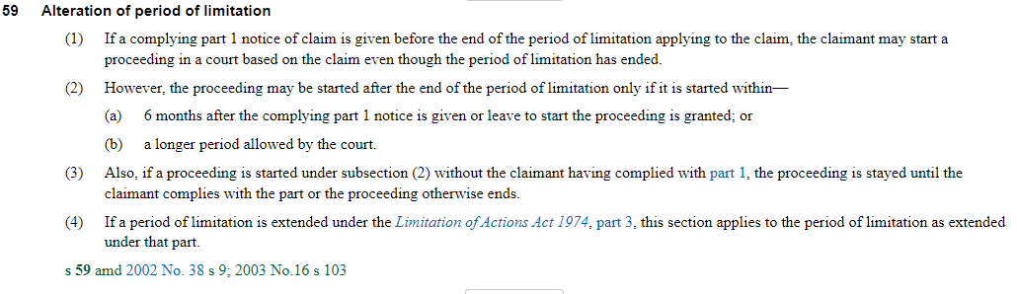
Starting proceedings after the limitation period has expired

Slide 32
Example cases
Filep v AMP Capital Investors Ltd & Anor [2016] QDC 300
Lee v Omni Leisure Operations Pty Ltd [2008] VSC 272
McDonald v Holy Spirit Care Services Ltd [2011] QDC 78
Tiver v Sunshine Coast Regional Council [2009] QDC 106

Slide 33



Slide 34


